Slide 1
PMP Study Group
Scope Management
A Guide to the Project Management Body of Knowledge (PMBOK)

Slide 2
Project Scope Management Definition
A subset of project management that includes the processes required to ensure that the project includes all of the work required, and only the work required, to complete the project successfully.

Slide 3
Project Scope Management IS…
Primarily concerned with defining and controlling what IS and IS NOT included in the project.

Slide 4
Project Scope Management Processes
5.1 Plan Scope Management
5.2 Collect Requirements
5.3 Define Scope
5.4 Create WBS (Work Breakdown Structure)
5.5 Validate Scope
5.6 Control Scope

Slide 5
Project Scope vs. Product Scope
Product Scope – the features and functions that characterize a product, service or result.
Project Scope – the work performed to deliver the product, service, or result with the specified features and functions.
“The term project scope is sometimes viewed as
including product scope”.

Slide 6
Completion Measures…
Completion of project scope is measure against the project management plan
Completion of product scope is measure against the product requirements

Slide 7
Scope Management Process Characteristics
Project Scope Management processes need to be well integrated with other Knowledge Area Processes
Each Project Scope Management process may involve effort from one or more individuals or groups of individuals based on the needs of the project

Slide 8
Plan Scope Management Process
Knowledge Area | Project Management Process Groups
 | Initiating | Planning | Executing | Monitoring & Controlling | Closing
5. Project Scope Management |  | 5.1 Plan Scope Management 5.2 Collect Requirements 5.3 Define Scope 5.4 Create WBS |  | 5.5 Validate Scope 5.6 Control Scope

Slide 9
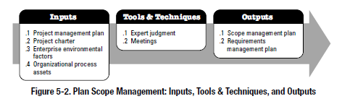
5.1 Plan Scope Management
Definition: “Plan Scope Management is the process of creating a scope management plan that documents how the project scope will be defined, validated, and controlled.”
PMBoK® Guide,5th Edition, page 107
PMBoK® Guide,5th Edition, page 107
Notes:
The key benefit of this process is that it provides guidance and direction on how scope will be managed through the project.

Slide 10
5.1.1 Plan Scope Management Inputs
5.1.1.1 | Project Management Plan | Approved subsidiary plans of the project management plan are used to create the scope management plan and influence the approach taken for planning scope and managing project scope. (See Section 4.2.3.1)
5.1.1.2 | Project Charter | Used to provide the project context needed to plan the scope management processes. It provides the high-level project description and product characteristics from the project statement of work. (See Section 4.1.3.1)
5.1.1.3 | Enterprise environmental factors | The Enterprise environmental factors that can influence the Plan Scope Management process include, but are not limited to: - Organization’s culture - Infrastructure - Personal Administration, and - Marketplace conditions (See Section 2.1.5)

Slide 11
5.1.1 Plan Scope Management Inputs (cont’d)
5.1.1.4 | Organizational process assets | The Organizational process assets that can influence the Plan Scope Management process include, but are not limited to: - Policies and Procedures, and - Historical information and lessons learned knowledge base (See Section 2.1.4)

Slide 12
5.1.2 Plan Scope Management Tools and Techniques
5.1.2.1 | Expert Judgment | Input received from knowledgeable and experienced parties. Expertise may be provided by any group or person with specialized education, knowledge, skill, experience, or training in developing scope management plans.
5.1.2.2 | Meetings | Used to develop the scope management plan. Attendees at these meetings may include the project manager, the project sponsor, selected team members, selected stakeholders, anyone with responsibility for any of the scope management processes, and others as needed.

Slide 13
5.1.3 Plan Scope Management Outputs
5.1.3.1 | Scope Management Plan | A component of the project or program management plan that describes how the scope will be defined, developed, monitored, controlled, and verified. The scope management plan is a major input into the Develop Project Plan Management process, and the other scope management processes. Components include: - Process for preparing a detailed project scope statement - Process that enable the creation of the WBS from the detailed project scope statement - Process that establishes how the WBS will be maintained and approved - Process that specifies how formal acceptance of the completed project deliverables will be obtained - Process to control how requests for changes to the detailed project scope statement will be processed. This process is directly linked to the Perform Integrated Change Control (Section 4.5).
Notes:
Note that the scope management plan can be formal, or informal, broadly framed or highly detailed, based upon the needs of the project.

Slide 14
5.1.3 Plan Scope Management Outputs (cont’d)
5.1.3.2 | Requirements Management Plan | A component of the project management plan that describes how requirements will be analyzed, documented, and managed. Components include: - How requirements activities will be planned, tracked, and reported - Configuration management activities such as: - How changes to the product will be integrated - How impacts will be analyzed - How they will be traced, tracked, and reported - Authorization levels required to approved changes - Requirements prioritization process - Product metrics that will be used and the rationale for using them - Traceability structure to reflect which requirement attributes will be captured on the Traceability Matrix.
Notes:
Note that the phase to phase relationship described in Section 2.4.2.1 strongly influences how requirements are managed. The PM selects the MOST effective relationship for the project and then documents that approach. Note that many of the Requirement management Plan’s components are based upon that relationship.

Slide 15
Plan Scope Management Terms
Project Charter | Used to provide the project context needed to plan the scope management processes. It provides the high-level project description and product characteristics from the project statement of work. (See Section 4.1.3.1)
Scope Management Plan | A component of the project or program management plan that describes how the scope will be defined, developed, monitored, controlled, and verified.
Requirements Management Plan | A component of the project management plan that describes how requirements will be analyzed, documented, and managed. The phase to phase relationship described in Section 2.4.2.1 strongly influences how requirements are managed. The PM selects the most effective relationship for the project and then documents that approach. Note that many of the Requirement management Plan’s components are based upon that relationship.

Slide 16
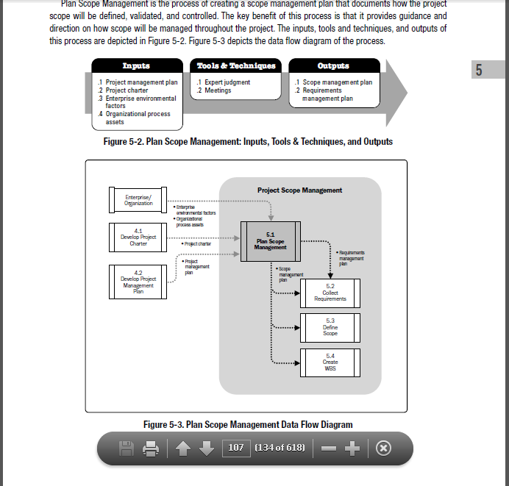
Plan Scope Management Data Flow
PMBoK® Guide,5th Edition, page 107

Slide 17
Collect Requirements Process
Knowledge Area | Project Management Process Groups
 | Initiating | Planning | Executing | Monitoring & Controlling | Closing
5. Project Scope Management |  | 5.1 Plan Scope Management 5.2 Collect Requirements 5.3 Define Scope 5.4 Create WBS |  | 5.5 Validate Scope 5.6 Control Scope

Slide 18
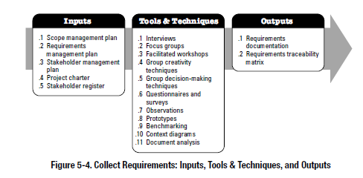
5.2 Collect Requirements
Definition: “Collect requirements is the process of determining, documenting, and managing stakeholder needs and requirements to meet the project objectives.”
PMBoK® Guide,5th Edition, page 110
PMBoK® Guide,5th Edition, page 111
Notes:
The key benefit of this process is that it provides the basis for defining and managing the project scope including the product scope.

Slide 19
5.2.1 Collect Requirements Inputs
5.2.1.1 | Scope Management Plan | Provides clarity as to how project teams will determine which type of requirements need to be collected for the project.
5.2.1.2 | Requirements Management Plan | Provides the processes that will be used throughout the Collect Requirements process to define and document the stakeholder needs.
5.2.1.3 | Stakeholder Management Plan | Used to understand stakeholder communication requirements and the level of stakeholder engagement in order to assess and adapt to the level of stakeholder participation in requirements activities. (See Section 13.2.3.1)
5.2.1.4 | Project Charter | Used to provide the high-level description of the service, or result of the project so that detailed requirements can be developed. (See Section 4.1.3.1)
5.2.1.5 | Stakeholder Register | Used to identify stakeholders who can provide information on the requirements. The stakeholder register also captures major requirements and main expectations stakeholders may have for the project. (See Section 13.1.3.1)
Notes:
Hand out an example of the Stakeholder Register.

Slide 20
5.2.2 Collect Requirements Tools and Techniques
5.1.2.1 | Interviews | A formal or informal approach to elicit information from stakeholders by talking to them directly. Typically performed by asking prepared and spontaneous questions and recording responses.
5.1.2.2 | Focus Groups | Pre-qualified Stakeholders and SME’s to learn about their expectations and attitudes about the proposed product, service or result. A trained moderator guides the group through an interactive discussion, designed to be more conversational than a one-on-one interview.
5.1.2.3 | Facilitated Workshops | Bring stakeholders together to define product requirements. Considered a primary technique for quickly defining cross-functional requirements and reconciling stakeholder differences. - Joint Application Development (JAD) - Quality Function Deployment (QFD)
5.1.2.4 | Group Creativity Techniques | - Brainstorming - Nominal Group Technique - Idea / Mind Maps - Affinity Diagrams - Multicriteria decision analysis
Notes:
.1 – Interviews are often conducted on an individual basis between the interviewer and an interviewee, but may involve multiple interviewers and / or multiple interviewees. Interviewing experience stakeholders and SME’s aids in identifying and defining features and functions of the desired product deliverable. Interviews are also useful for obtaining confidential information.
.3- JAD – Bring developers and users together to improve the software development process
.3- QFD – is used mostly in Manufacturing, is used to define critical characteristics of new product development. The first step is to collect customer needs, which is referred to as the “Voice of the Customer”. Needs are sorted and prioritized. Like in the Agile methodology, User Stories are defined during workshops. These User stories:
Role – Describes the stakeholder who benefits for the feature
Goal – Describes what is to be accomplished
Motivation – The benefit to the stakeholder
Hand out examples – Mind Map and Affinity Diagrams
.4- Brainstorming – A technique used to generate and collect multiple ideas. Brainstorming does not use a voting process to prioritize ideas, but it is often used in conjunction with other tools that do.
- Nominal Group Technique – typically applied during a brainstorm session where ideas are ranked and / or prioritized.
- Idea / Mind Maps – Diagrams ideas created through brainstorm sessions and consolidates them into a single map to reflect commonality and differences in understanding, and generate new ideas. The finished map resembles branches on a tree.
Affinity Diagrams – ideas collected are sorted into groups by similarity for review and analysis. These groupings aid in identifying scope omissions and risk elements.
Multicriteria decision analysis – Utilizes a decision matrix to provide a systematic analytical approach for establishing criteria, such as risk levels, uncertainty, and valuation, to evaluate and rank ideas.
Hand out a Multicriteria decision analysis example

Slide 21
5.2.2 Collect Requirements Tools and Techniques (cont’d)
5.2.2.5 | Group Decision Making Techniques | Used to assess multiple alternatives: - Unanimity - Majority - Plurality - Dictatorship
5.2.2.6 | Questionnaires and Surveys | A written set of questions designed to quickly accumulate information from a large number of respondents. Questionnaires and surveys are most appropriate with varied audiences, when a quick turn-around is needed, when respondents are geographically dispersed, and where statistical analysis is appropriate.
5.2.2.7 | Observations | Job Shadowing.
5.2.2.8 | Prototypes | Obtains early feedback on requirements by providing a working model of the expected product before actually building it. Proto-types support the model of progressive elaboration in iterative cycles of mock-up creation. Storyboards is a prototyping technique showing sequence or navigation through a series of images or illustrations.
Notes:
.5 - Group Decision Making Techniques – used to assess multiple alternatives:
- Unanimity – Everyone agrees
- Majority – Support by more than 50%
- Plurality – The largest block in a group decides
Dictatorship – One individual makes the decision for the entire group
.7 – Observations – viewing individuals in their work environment and how they perform their job or tasks, and carry out processes.

Slide 22
5.2.2 Collect Requirements Tools and Techniques (cont’d)
5.2.2.9 | Benchmarking | Involves comparing actual or planned practices, such as processes and operations, to those of comparable organizations to identify best practices, generate ideas for improvement, and provide a basis for measuring performance. Comparisons can be made with both internal and external organizations.
5.2.2.10 | Context Diagrams | Depict the product’s scope by showing a business system (process, equipment, computer system, etc.), and how people and systems (actors) interact with it. Context diagrams illustrate inputs and outputs.
5.2.2.11 | Document Analysis | Used to elicit requirements by analyzing existing documentation and identifying information relevant to the requirements. Examples of documents to be analyzed can include, but are not limited to: - Business Plans - Marketing literature - Agreements - Requests for Proposals - Current Process Flows - Logical data models - Business rules, etc.

Slide 23
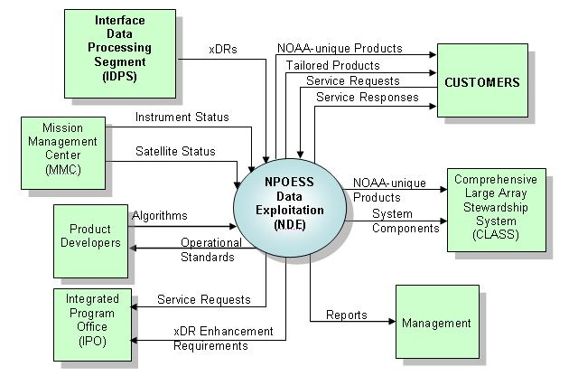
Context Diagram Example
Source: Wikipedia
Notes:
Hand out Context Diagram

Slide 24
5.2.3 Collect Requirements Outputs
5.2.3.1 | Requirements Documentation | Requirements documentation describes how individual requirements meet the business need for the project. Components include: - Business Requirements - Stakeholder Requirements - Solution Requirements - Project Requirements - Transition Requirements - Requirements Assumptions, Dependencies, and Constraints
Notes:
.1 – Requirements start out being high-level but become progressively more detailed as more about the requirements become know. Before being base-lined, requirements need to be unambiguous (measureable and testable), traceable, complete, consistent, and acceptable to all of the stakeholders.

Slide 25
5.2.3 Collect Requirements Outputs (cont’d)
5.2.3.2 | Requirements Traceability Matrix | A grid that links product requirements from their origin to the deliverables that satisfy them. A Traceability Matrix helps ensure that each requirement adds business value by linking it to the business and product objectives. Tracing requirements can include: - Business needs, opportunities, goals and objectives - Project objectives - Project Scope / WBS deliverables - Product Design - Product development - Test strategy and test scenarios - High-Level Requirements to more detailed requirements

Slide 26
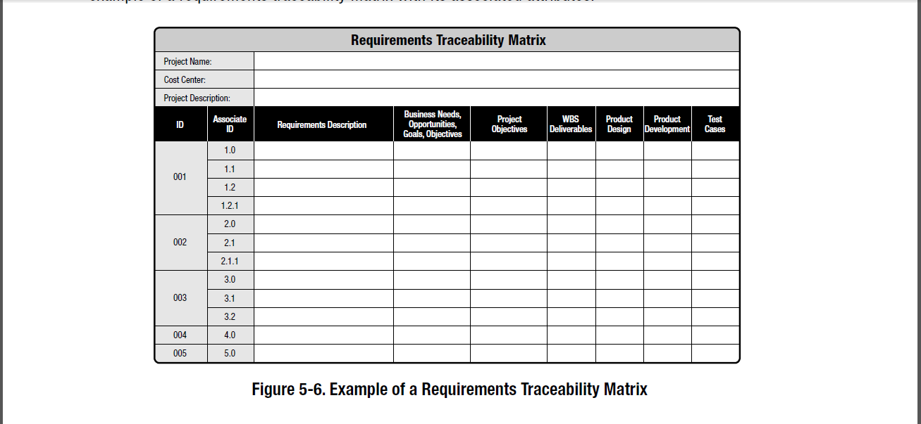
Requirements Traceability Matrix
PMBoK® Guide,5th Edition, page 119

Slide 27
Collect Requirements Terms
Context Diagrams | A visual depiction of the product’s scope by showing a business system (process, equipment, computer system, etc.), and how people and systems (actors) interact with it. Context diagrams illustrate inputs and outputs.
Multi-Criteria Decision Analysis | A decision matrix to provide a systematic analytical approach for establishing criteria, such as risk levels, uncertainty, and valuation, to evaluate and rank ideas.
Facilitated Workshop Techniques | Joint Application Development – Bring developers and users together to improve the software development process Quality Function Deployment – Is used determine critical characteristics of new product development. A method applied to collect customer needs is called the Voice of the Customer (VOC)

Slide 28
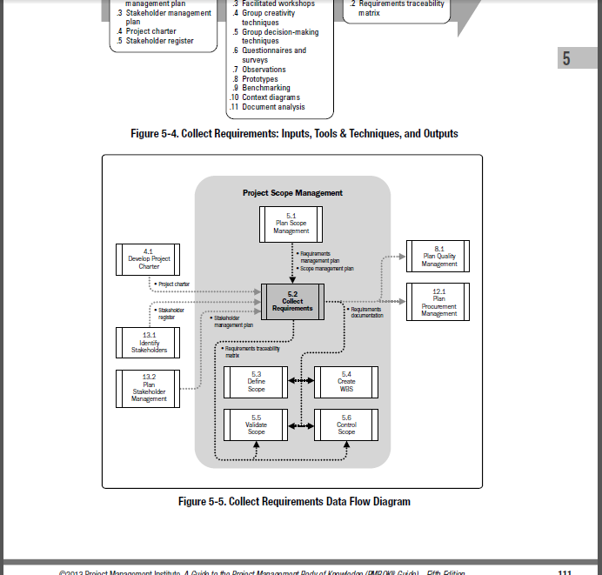
Collect Requirements Data Flow
PMBoK® Guide,5th Edition, page 111

Slide 29
Define Scope Process
Knowledge Area | Project Management Process Groups
 | Initiating | Planning | Executing | Monitoring & Controlling | Closing
5. Project Scope Management |  | 5.1 Plan Scope Management 5.2 Collect Requirements 5.3 Define Scope 5.4 Create WBS |  | 5.5 Validate Scope 5.6 Control Scope

Slide 30
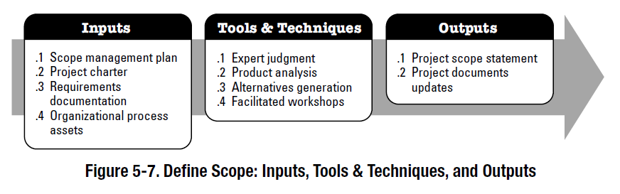
5.3 Define Scope
Definition: “The process of developing a detailed description of the project or product.”
PMBoK® Guide,5th Edition, page 120
PMBoK® Guide,5th Edition, page 120
Notes:
The key benefit of this process is that it describes the project, service, or result boundaries by defining which of the requirements collected will be included in and excluded from the project scope.

Slide 31
Define Scope Note:
When there is poor scope definition, final project costs can be expected to be higher because of the inevitable changes which disrupt project rhythm, cause rework, increase project time, and lower the productivity and morale of the workforce.

Slide 32
5.3.1 Define Scope Inputs
5.3.1.1 | Scope Management Plan | Described in Section 5.1.3.1. – The Scope management plan is a component of the project Management plan that establishes the activities for developing, monitoring, and controlling the project scope.
5.3.1.2 | Project Charter | Described in Section 4.1.3.1. - Project Charter provides the high-level project description and product characteristics.
5.2.1.3 | Requirements Documentation | Described in Section 5.2.3.1. – Requirements documentation is used to select the requirements that will be included in the project.
5.2.1.4 | Organizational Process Assets | - Policies, procedures and templates for a project scope statement - Project files from previous projects, and - Lessons learned from previous phases or projects

Slide 33
5.3.2 Define Scope Tools and Techniques
5.3.2.1 | Expert Judgment | Solicit SME’s. Examples – Other business units within the organization, Consultants, Stakeholders, including customer and sponsors, professional and technical associations, industry groups and Subject Matter Experts.
5.3.2.2 | Product Analysis | Involves translating high-level product descriptions into tangible deliverables.
5.3.2.3 | Alternatives Identification | Used to develop as many potential options as possible in order to identify different approaches to execute and perform the work of the project. Tools include: - Brainstorming - Lateral Thinking - Analysis of alternatives
5.3.2.4 | Facilitated Workshops | See section 5.2.2.3 - Joint Application Development - Quality Function Deployment
Notes:
.3 - Alternatives Identification:
Lateral Thinking- Lateral Thinking refers to a means of escaping from habitual mind patterns (or logical sequential thinking) in order to solve problems or explore new ideas. Techniques include deliberate and provocative challenging of preconceptions, and rejection of yes/no thinking. A person would use lateral thinking when they want to move from one known idea to creating new ideas.
Hand out Six Hats example
Six Thinking Hats - is a simple, effective process that helps people be more productive, focused, and mindfully involved. And once learned, the tools can be applied immediately. You and your team members can learn how to separate thinking into six clear functions and roles. Each thinking role is identified with a colored symbolic "thinking hat." By mentally wearing and switching "hats," you can easily focus or redirect thoughts, the conversation, or the meeting. (See handout). The process working by have each team member assume a role (color) and play-act that hats characteristics. Then after the discussion is exhausted, the players change hats in clock-wise direction and repeat the exercise, now with new perspectives. Continue until everyone has played every role.
.4 Facilitated Workshops:
Joint Application Development – Bring developers and users together to improve the software development process
Quality Function Deployment – Is used determine critical characteristics of new product development.

Slide 34
5.3.3 Scope Definition Outputs
5.3.3.1 | Project Scope Statement | - The scope statement documents the entire scope, including project and product scope. It describes in detail, the deliverables and the work required to create those deliverables. - Provides a common understanding of Scope among Stakeholders. - Describes explicit scope exclusions - Provides a basis to determine if changes in project scope are contained within or outside the project’s boundaries. - Project Scope Statement must include: - Project Scope Description - Product Acceptance Criteria - Project Deliverables - Project Exclusions - Project Constraints - Project Assumptions
5.3.3.2 | Project Document Updates | - Stakeholder Register - Requirements Documentation - Requirements Traceability Matrix
Notes:
.1 – The Project Scope Statement provides the base-line for evaluating whether requests for changes or additional work are contained within or outside the project’s boundaries.

Slide 35
Define Scope Terms
Organizational Process Assets | Any and all of the organizations involved in the project can have formal and informal policies, procedures, plans and guidelines whose effects must be considered. Organizational Process Assets are also represented by lessons learned from previous projects with specific emphasis on: - Completed Schedules - Risk Data - Earned Value data
Project Scope Statement | Contains the following elements: - The Project’s deliverables and the work required to create them - A common understanding of Scope among Stakeholders - Explicit scope exclusions - Provides a basis to determine if changes in project scope are contained within or outside the project’s boundaries

Slide 36
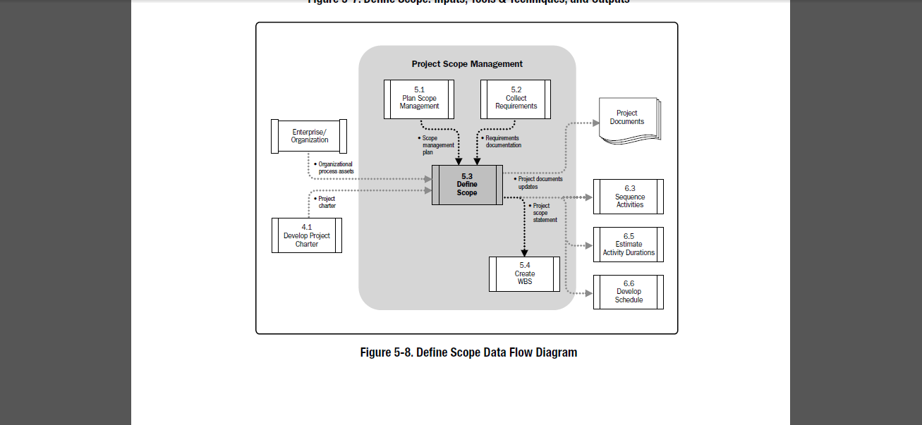
Define Scope Data Flow
PMBoK® Guide,5th Edition, page 120

Slide 37
Create WBS Process
Knowledge Area | Project Management Process Groups
 | Initiating | Planning | Executing | Monitoring & Controlling | Closing
5. Project Scope Management |  | 5.1 Plan Scope Management 5.2 Collect Requirements 5.3 Define Scope 5.4 Create WBS |  | 5.5 Validate Scope 5.6 Control Scope

Slide 38
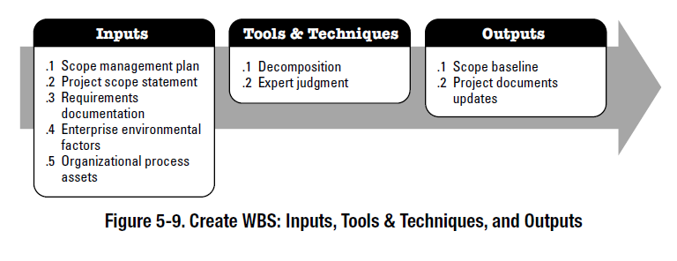
5.4 Create WBS
Definition: “The process of subdividing project deliverables and project work into smaller, more manageable components.”
PMBoK® Guide,5th Edition, Glossary, p. 535
PMBoK® Guide,5th Edition, p. 125
Notes:
The key benefit of this process is that it provides a structured vision of what has to be delivered.

Slide 39
Work Breakdown Structure (WBS)
The WBS is a hierarchical decomposition of the total scope of work to be carried out by the project team to accomplish the project objectives and create the required deliverables. The WBS organizes and defines the total scope of the project, and represents the work specified in the current approved project scope statement.
Notes:
Key points in this definition:
- Deliverable-oriented, deliverables are called work packages, work packages are the lowest level of detail in the WBS
- Organizes and defines
- Increasingly detailed definition of the work
A WBS is the foundation for good planning and control of a project.
Ask the students if they would rather build a home on a foundation of sand or rock.
What would happen in each case ?

Slide 40
5.4.1 Create WBS Inputs
5.4.1.1 | Scope Management Plan | Described in Section 5.1.3.1 – Defines processes: - for preparing a detailed project scope statement - that enables the creation of the WBS form the detailed project scope statement - that establishes how the WBS will be maintained and approved - that specifies how the formal acceptance of the completed project deliverables will be obtained - to control how requests for changes to the detailed project scope statement will be processed
5.4.1.2 | Project Scope Statement | Described in Section 5.3.3.1 - Contains the following elements: - Product scope description - Acceptance criteria - Deliverable; Any unique and verifiable product, result, or capability required to be produced to complete a process, phase or project - Project exclusion; identifies what is excluded from project - Constraints; limiting factors that affects the execution of a project or process. - Assumptions
Notes:
.2 Examples of:
- Acceptance criteria: The data processing system will be able sustain a rate of 1,000,000 transactions per minute; The system will pass all predefined test cases developed by the QA department.
- Constraints: Budget ; Staffing capabilities; Time frame; Legal / government / environmental.
- Assumptions: Cost drivers - Systems analysis and design will be completed by existing staff, coding will be completed by a contracted personnel.

Slide 41
5.4.1 Create WBS Inputs (cont’d)
5.4.1.3 | Requirements Documentation | Described in Section 5.2.1.3 - Contains the following elements: - Business requirements, including: - Business and project objectives for traceability - Business rules for the performing organization - Guiding principles of the organization - Stakeholder requirements, including: - Impacts to other organizational areas - Impacts to other entities inside or outside the performing organization - Stakeholder communication and reporting requirements - Solution Requirements, including: - Functional and nonfunctional requirements - Technology and standard compliance requirements - Support and training requirements - Quality requirements - Reporting requirements, etc.

Slide 42
5.4.1 Create WBS Inputs (cont’d)
5.4.1.3 | Requirements Documentation (cont’d) | Project Requirements, such as: - Levels of Service, performance, safety, compliance, etc. - Acceptance criteria - Transition requirements - Requirements assumptions, dependencies, and constraints
5.4.1.4 | Enterprise Environmental Factors | Described in Section 2.1.5 – Industry-specific WBS standards, relevant to the nature of the project. For example, an engineering project may refer to ISO.IEC 15288 on Systems Engineering - Systems Life Cycle Processes to create a WBS for a new project.
5.4.1.5 | Organizational Process Assets | Described in Section 2.1.4 – Contains the following elements but not limited to: - Policies, procedures, and templates for the WBS - Project files from previous projects - Lessons learned from previous projects
Notes:
.4 - Examples of environmental factors include:
Organizational culture, structure and governance
Geographic distribution of facilities and resources
Government or industry standards
Infrastructure
Personnel Administration (Staffing, retention guidelines, employee performance reviews, etc)
Work authorization processes
Marketplace conditions
Stakeholder risk tolerance
Political climate
Project Management Information System

Slide 43
5.4.2 Create WBS Tools and Techniques
5.4.2.1 | Decomposition | A technique used for dividing and subdividing the project scope and deliverables in to smaller more manageable parts. This involves: Identifying and analyzing the deliverables and related work. Structuring and organizing the WBS. Decomposing the upper WBS levels into lower level detailed components. Developing and assigning identification code to the WBS components. Verifying that the degree of decomposition of the deliverables is appropriate.
Notes:
.1
- The work package is the lowest level of the WBS that cost and duration can be estimated and managed

Slide 44
5.4.2 Create WBS Tools and Techniques (cont’d)
5.4.2.2 | Expert Judgment | Expert judgment is often used to analyze the information needed to decompose the project deliverables down into smaller component parts in order to create an effective WBS. Expertise is provided by any group of individual with relevant training, knowledge, or experience with similar projects or business areas. Predefined industry or disciple specific templates may also be used to provide guidance on the effective breakdown of deliverables into smaller units of work.
Notes:
Delphi Technique: Interviewing multiple subject matter experts (SME) and building consensus.
- Polling of these experts is done on an anonymous basis.
- Gathering opinions that are not biased by fears or identifiable.
- The responses from all experts are typically combined in the form of an overall summary.
- The summary can in turn be provided to the experts for a review and additional comments.
- The goal is to build consensus, minimize bias, and reduce possibility that a single person can have too much influence on the outcome.

Slide 45
WBS Templates
Organization of the WBS will tend to highlight either the product or the process
No advantage to using one or the other
Multiple presentations may be needed based on what needs to be communicated to the stakeholders

Slide 46
Product-Oriented WBS
Software
Release
1. Software
2. Doc.
3. Training
4. Proj. Mgt.
1.1 Build 1
3.1 User
1.2 Build 2
3.2 Tech. Sup.
1.3 Impl.
3.3 Call Ctr.
1.4 Testing
1.4.1 User
1.4.2 Functional
Notes:
Notice the deliverables of this project are at the top level of the WBS. Deliverables are broken into components and subcomponents.
Also look at the numbering system of this WBS.

Slide 47
Process-Oriented WBS
Software
Release
1. Design
2. Build
3. Test
4. Release
1.1 System
2.1 Build 1
3.1 Test B1
4.1 Release System
1.2 Build 1
2.2 Build 2
3.2 Test B2
4.2 Release Doc.
1.3 Build 2
2.3 Integrate System
3.3 Test System
1.4 Doc.
2.4 Write Doc.
3.4 Test Doc.
Notes:
This is the same project as the previous slide built in a process-oriented manner rather than the product-oriented manner. The project team will design, build, test, and release the software system and the documentation, but the training has been overlooked. This is a common mistake when organizing a project in any other manner other than by product.
It is helpful to initially break down the work by deliverable because it helps to ensure that the entire scope is addressed. The WBS can then be rearranged in whatever manner required without concern for missing a critical component.

Slide 48
WBS Templates (cont’d)
Numbering – Applying numbers to the various work elements lets project team members know where work fits together within the project.
Various other Breakdown Structures include:
Organizational Breakdown Structure (OBS) – i.e.: Org Chart
Risk Breakdown Structure (RBS): illustrates the potential risks on the project, broken down by risk category
Resource Breakdown Structure: illustrates the type of resources required on the project.
Bill Of Materials (BOM): includes all components, assemblies and sub-assemblies required to build the product.
Notes:
Be sure to emphasize the various Breakdown structures used, particularly the BOM

Slide 49
5.4.3 Create WBS Outputs
5.4.3.1 | Scope Baseline | The scope baseline is the approved version of a scope statement, WBS and it’s associate WBS dictionary, that can be changed only through formal change control procedures and is used as a basis for comparison. The scope baseline is a component of the project management plan and includes: - The Project scope statement, includes the description of the project scope, major deliverables, assumptions, and constraints. - The WBS, work not in the WBS is not in the scope of the project. - Identifies ALL the work to be performed and includes the identification of work packages. - A work package is the lowest level of definition. It is where resources are expended. - Assigns a unique identifier to each Work Package collectively called the “code of accounts.” - Provides the basis for estimating staff, cost and time. - Is a graphical visualization of the work package hierarchy. - Helps prevent gold plating and scope creep.

Slide 50
5.4.3 Create WBS Outputs (cont’d)
5.4.3.1 | Scope Baseline (cont’d) | - The WBS dictionary, is a document that support the WBS and provides detailed deliverables, activity, and scheduling information about each component in the WBS. The WBS dictionary may include: - Code of accounts identifier - Description of work, assumptions and constraints - Schedule milestones, and associated schedule activities - Responsible organization and resources required - Cost Estimates - Quality requirements and acceptance criteria - Technical References - Agreement information

Slide 51
5.4.3 Create WBS Outputs (cont’d)
5.4.3.2 | Project Document Updates | Project documents that may be updated include requirements documentation, which may need to be updated to include approved changes. If approved changes requests result from the Create WBS process, then the requirements documentation may need to be updated to include approved changes.

Slide 52
WBS Packages
Control Accounts – Scope not yet defined:
Data is a place-holder
Rolling Wave planning
Planning Packages:
One level above the Work Package (where work is performed)
Scope has been defined, but work not yet detailed.

Slide 53
WBS Packages (cont’d)
Control
Account
Software
Release
1. Software
2. Doc.
3. Training
4. Proj. Mgt.
1.1 Build 1
3.1 User
1.2 Build 2
Planning
Package
3.2 Tech. Sup.
1.3 Impl.
3.3 Call Ctr.
1.4 Testing
1.4.1 User
Work
Package
1.4.2 Functional
Notes:
The circled elements on this WBS chart identify the lowest level of detail within each hierarchy (Product oriented WBS)

Slide 54
Create WBS Terms
Decomposition | A technique used for dividing and subdividing the project scope and project deliverables into smaller, more manageable parts.
PMBoK® Guide,5th Edition, Glossary, p. 536
Work Breakdown Structure - WBS | Deliverable-oriented grouping of the project elements that organizes and defines the total scope of the project: work not in WBS is not in scope! Each item in WBS is assigned a unique identifier collectively called the “code of accounts” Items at the lowest level are referred to as the “work packages”. Work element descriptions = WBS Dictionary work package descriptions + dates +cost budgets + resource assignments.
Work Breakdown Structure Templates | A work breakdown structure from a previous project with similar deliverables and project life cycle. “Reuse”. Some are standard or semi-standard (e.g.: US DOD has defined one for Defense Material Items. Standard software development processes within a particular organization.

Slide 55
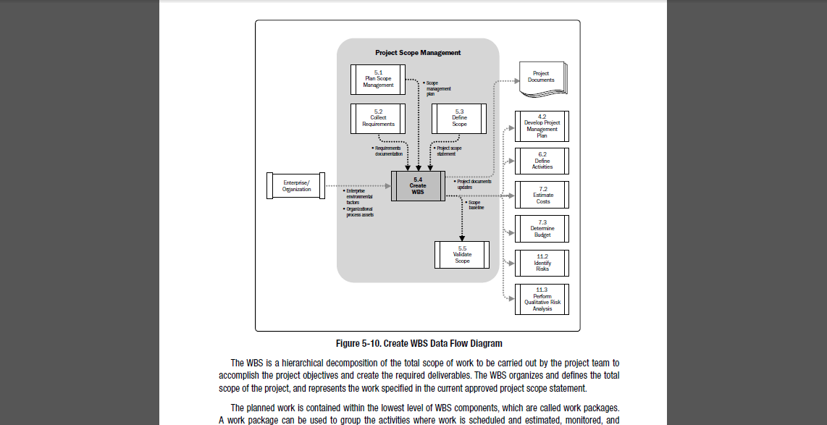
Create WBS Data Flow
PMBoK® Guide,5th Edition, p. 126

Slide 56
Validate Scope Process
Knowledge Area | Project Management Process Groups
 | Initiating | Planning | Executing | Monitoring & Controlling | Closing
5. Project Scope Management |  | 5.1 Plan Scope Management 5.2 Collect Requirements 5.3 Define Scope 5.4 Create WBS |  | 5.5 Validate Scope 5.6 Control Scope

Slide 57
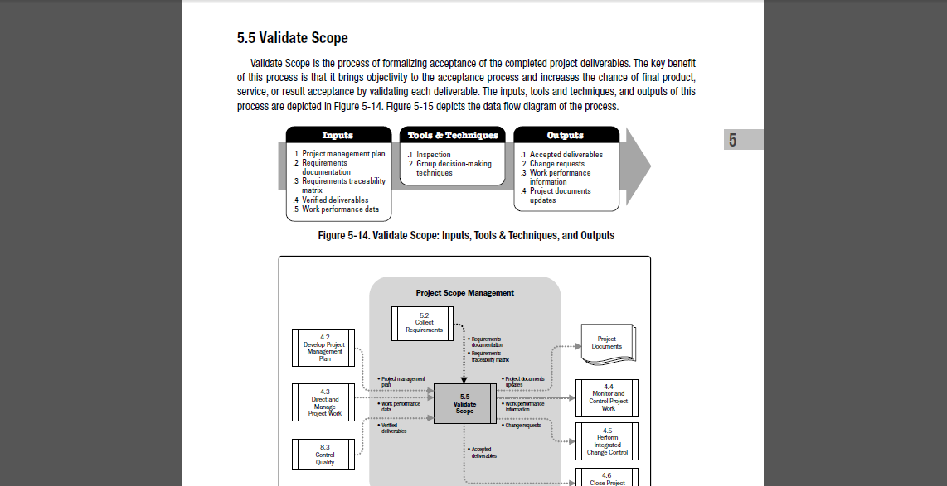
5.5 Validate Scope
Definition: “The process of formalizing acceptance of the competed project deliverables.”
PMBoK® Guide,5th Edition, Glossary, p. 566
PMBoK® Guide,5th Edition, p. 133
Notes:
The key benefit of this process is that it brings objectivity to the acceptance process and increases the chance of the final product, service, or result acceptance by validating each deliverable.

Slide 58
5.5.1 Validate Scope Inputs
5.5.1.1 | Project Management Plan | Described in section 4.2.3.1. the project management plan contains the project’s scope management plan and the scope baseline. - The scope management plan specifies how formal acceptance of the completed project deliverables will be obtained. - The scope baseline contains: - Project Scope Statement - WBS - WBS dictionary
5.5.1.2 | Requirements Documentation | Described in section 5.2.3.1. Lists all project, product, and other types of requirements for the project and product, along with their acceptance criteria.
5.5.1.3 | Requirements Traceability Matrix | Described in section 5.2.3.2. A table that links requirements to their origin and traces them through the Project Life Cycle.
5.5.1.4 | Validated Deliverables | Described in section 8.3.3.3. Validated deliverables have been completed and checked for correctness by the Quality Control Process.
5.5.1.5 | Work Performance Data | Described in Section 4.3.3.2. Work performance data can include the degree of compliance with requirements, number of nonconformities, severity of the nonconformities, or the number of validation cycles performed in a period of time.
Notes:
.2 Components include:
Business Need / Objective
Functional Requirements
Non-Functional Requirements
Quality Requirements
Acceptance Criteria
Corporate Business Processes / Rules
Impacts to other Business Areas within the Organization
Impacts to other entities
Support and Training requirements
Assumptions and Constraints
.4 - Perform Quality Control Process – See Section 8.3.3.3
A goal of the Quality process is to determine the correctness of deliverable. The results of performing the Quality Control Process are validated deliverable.

Slide 59
5.5.2 Validate Scope Tools and Techniques
5.5.2.1 | Inspection | Inspection includes activities such as measuring, examining and validating to determine whether work and deliverables meet requirements and product acceptance criteria. Inspections are sometimes called reviews, product reviews, audits and walkthroughs. In some applications areas, these different terms have unique and specific meanings.
5.5.2.2 | Group Decision-Making Techniques | Described in section 5.2.2.5. These techniques are used to reach a conclusion when the validation is performed by the project team and other stakeholders.
Notes:
.1 – Inspection –
Physical inspection of size, shape, weight, and other properties.
Logical inspection; Software code reviews for company or departmental standards, industry best practices etc.
.2 - Group Decision Making Techniques – used to assess multiple alternatives:
- Unanimity – Everyone agrees
- Majority – Support by more than 50%
- Plurality – The largest block in a group decides
Dictatorship – One individual makes the decision for the entire group

Slide 60
5.5.3 Validate Scope Outputs
5.5.3.1 | Accepted Deliverables | See Section 4.6 – Deliverables that meet acceptance criteria are formally signed off and approved by the customer or sponsor. Formal documentation received from the customer or sponsor acknowledging formal stakeholder acceptance of the projects deliverable is forwarded to the Close Project of Phase process.
5.5.3.2 | Change Request | See Section 4.5 – The completed deliverables that have no been formally accepted are documented, along with reasons for non-acceptance of those deliverables. Those deliverables may require a change request for defect repair. The change requests are processed for review and disposition through the Perform Integrated Change Control process.
5.5.3.3 | Work Performance Information | See Section 10.3.3.1 – Work performance information includes information about project progress, such as which deliverables have started, their progress, which deliverables have finished , or which have ben accepted. This information is documented then communicated to stakeholders.
5.5.3.4 | Project Document Updates | Project Documents that may be updated as a result of the Validate Scope process include any documents that define the product or report status on product completion. Verified documents may require approvals from customer or sponsor in the form of signatures or signoffs.
Notes:
.1 – Close Project or Phase is the process of finalizing all activities across all of the Project Management Process Groups to formally complete the project or phase.
.2 – Perform Integrated Change Control is the process of reviewing all change requests, approving changes and maintaining changes to the deliverables, organizational process assets, project documents and the project management plan.
.3 – Work performance information – organizes and summaries the performance data gathered. Performance data typically provides status and progress information on the project at the level of detail required by the various stakeholders.
.4 – Project Documents that may be updated, but are not limited to requirements documentation. If approved change requests result from the Create WBS process, then the requirements documentation may need to be updated to include approved changes.

Slide 61
Scope Validation Terms
Inspection | Measuring, examining and testing to determine if results conform to requirements (reviews, product reviews, audits and walk-throughs).
Formal Acceptance | Documentation that client or sponsor has accepted the product of the project or phase. May be conditional, especially at end of phase.
Acceptance, Not Correctness | The Verify Scope phase is primarily concerned with the acceptance of the product or service which the project delivers. Correctness of the tangible deliverable is addressed in the Quality Management Knowledge area.
Notes:
Stress Acceptance, Not Correctness.

Slide 62
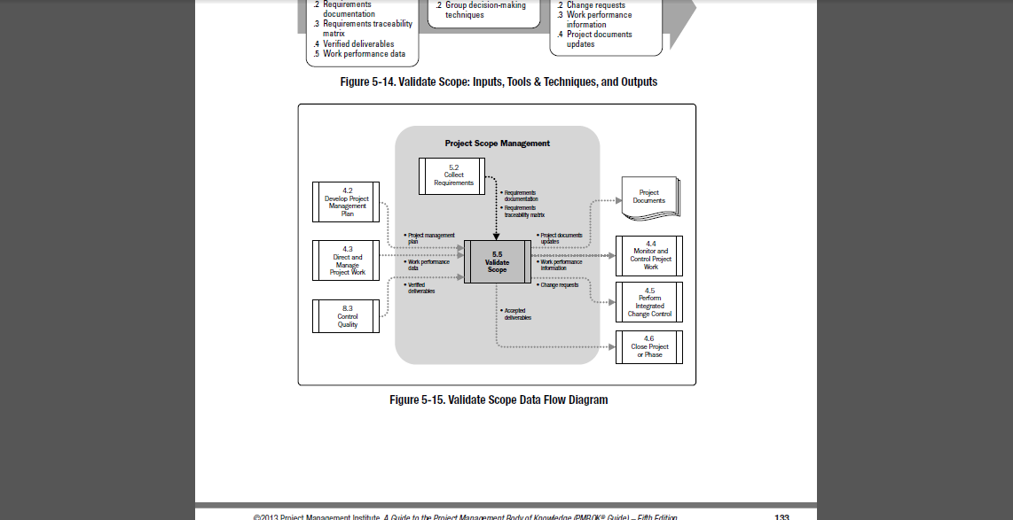
Validate Scope Data Flow
PMBoK® Guide,5th Edition, p. 133

Slide 63
Control Scope Process
Knowledge Area | Project Management Process Groups
 | Initiating | Planning | Executing | Monitoring & Controlling | Closing
5. Project Scope Management |  | 5.1 Plan Scope Management 5.2 Collect Requirements 5.3 Define Scope 5.4 Create WBS |  | 5.5 Validate Scope 5.6 Control Scope

Slide 64
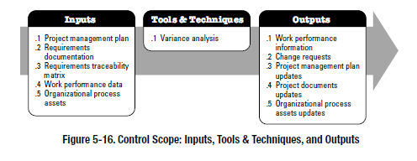
5.6 Control Scope
Definition: “The process of monitoring the status of the project and product scope and managing changes to the scope baseline.”
PMBoK® Guide, 5th Edition, Glossary, p. 534
PMBoK® Guide,5th Edition, p. 136
Notes:
The key benefit of this process is that it allows the scope baseline to be managed throughout the project.

Slide 65
5.6.1 Control Scope Inputs
5.6.1.1 | Project Management Plan | Described in section 4.2.3.1. contains: - Scope baseline, scope baseline is compared to actual results to determine if a change, corrective action, or preventative action is necessary. - Scope management plan, sections from this plan describe how the scope will be monitored and controlled. - Change management plan, defines the process for managing change on the project. - Configuration management plan, defines those items that are configurable, those items that require formal change control, and the process for controlling changes to such items. - Requirements management plan, is a component of the project management plan and describes how the project requirements will be analyzed, documented, and managed.
5.6.1.2 | Requirement Documentation | Described in Section 5.2.3.1. – requirements should be unambiguous, traceable, complete, consistent and acceptable to key stakeholders
5.6.1.3 | Requirements Traceability Matrix | Described in Section 5.2.3.2. – helps to detect the impact of any change or deviation from the scope baseline on the project objectives.
5.6.1.4 | Work Performance Data | Described in Section 4.3.3.2. – can include the number of change requests received, the number of accepted or the number of deliverables completed.

Slide 66
5.6.1 Control Scope Inputs (cont’d)
5.6.1.5 | Organizational Process Assets | - Described in Section 2.1.4. – the organizational process assets that can influence the Control Scope process include the following. - Existing formal and informal scope, control-related: - Polices, procedures and templates for the WBS - Project files from previous projects - Lessons Learned from previous projects

Slide 67
5.6.2 Control Scope Tools and Techniques
5.6.2.1 | Variance Analysis | - Is a technique for determining the cause and degree of difference between the baseline and actual performance. - Project performance measurements are used to assess the magnitude of variation from the original scope baseline. - Important aspects of project scope control include determining the cause and degree of variance relative to the scope baseline (Section 5.4.3.1) and deciding whether corrective or preventative action is required.

Slide 68
5.6.3 Control Scope Outputs
5.6.3.1 | Work Performance Information | - Includes correlated and contextualized information on how the project scope is performing compared to the scope baseline - It can include the categories of the changes received, the identified scope variances and their causes, how they impact schedule or cost, and the forecast of the future scope performance. - This information provides a foundation for making scope decisions.
5.6.3.2 | Change Requests | - Analysis of scope performance can result in a change request to the scope baseline or other components of the project management plan. - Change requests can include preventative or corrective actions, defect repairs or enhancement requests. - Change requests are processed for review and disposition according o the Perform Integrated Change Control process (Section 4.5)
5.6.3.3 | Project Management Plan Updates | - Scope Baseline Updates – If the approved change requests have an effect on the project scope, then the scope statement, the WBS, and the WBS dictionary are revised and reissued to reflect the approved change through Perform Integrated Change Control. - Other Baseline Updates – if the approved change requests have an effect on the project besides the project scope, the the corresponding cost and schedule
Notes:
.2 - Requests for a change can be direct or indirect, externally or internally initiated, and can be optional or legally / contractually mandated and can include:
Corrective Action
Preventative Action
Defect Repair
Updates

Slide 69
5.6.3 Control Scope Outputs (cont’d)
5.6.3.4 | Project Document Updates | - May include but are not limited to: - Requirements documentation - Requirements traceability matrix
5.6.3.5 | Organizational Process Asset Updates | - May include but are not limited to: - Causes of variances - Corrective action chosen and the reason - Other types of lessons learned from project scope control

Slide 70
Scope Change Control Terms
Performance Reports | Documents that provide organized and summarized work performance, earned value management parameters and calculations, and analyses of project work progress work status
Scope Change Control System | Procedures by which project scope may be changed: paperwork, tracking systems and approval levels necessary for authorization. Should be integrated with the overall change control system as well as that in place to control product scope. Under a contract, the scope control system must also comply with all relevant contractual provisions.
Scope Changes | Any modification to the agreed-upon project scope as defined by the approved WBS. Often require changes to cost, time, quality, or other project objectives. Scope changes are fed back through the planning process, technical and planning documents are updated as needed, and stakeholders are notified as appropriate.
Corrective Action | Anything done to bring expected future project performance into line with the project plan.
Adjusted Baseline | The nature of the change may require that the corresponding baseline document be revised and reissued to reflect the approved change & form the new baseline for future changes.

Slide 71
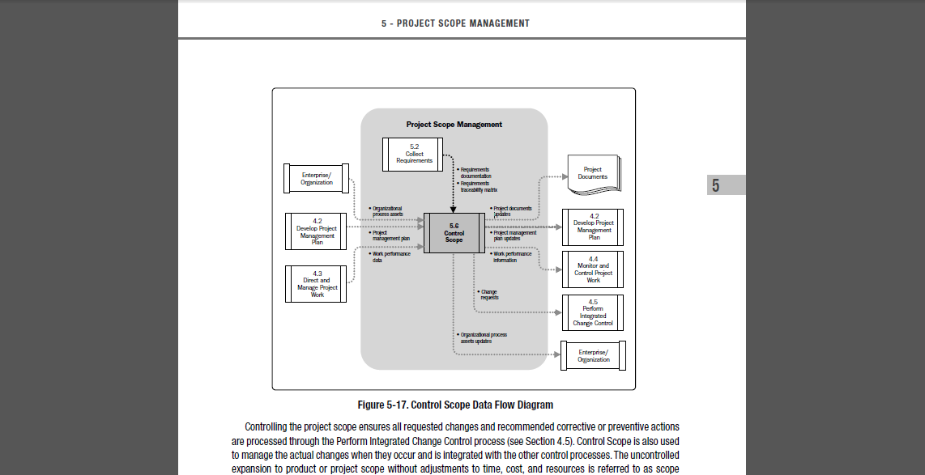
Control Scope Data Flow
PMBoK® Guide,5th Edition, p. 137

